Slide 1
Becoming and Staying Middle Class in Contemporary India The role of family strategies

Slide 2
Shifts in class structure – 1980s -
Class differentiation since the 1980s and expansion of the “middle class”
Middle classes and not ‘a’ middle class – extreme heterogeneity
Is there a “new” middle class?

Slide 3
Becoming middle class
Becoming middle class the dream of millions of Indians
Importance of taking seriously “Self- ascription” as middle class – many more people identifying themselves as middle class today

Slide 4
Sara Dickey in Madurai
1985-87 - almost nobody identified themselves as middle class, there were just rich and poor people
1991-1992 – those with house-help began to identify themselves as middle and upper class
1999 – the poor also spoke of a three-part class structure with one being the middle class
She says: ‘middle classness’ has become socially more signiﬁcant, and culturally more elaborated, over the past two decades in Madurai

Slide 5
Devesh Kapur and Milan Vaishnav’s survey findings
49 per cent of their respondents self-identified as “middle class.”
45 per cent of those who were in the lowest income bracket self-identified as middle class, barely 3 per cent less than the richest income group.
“Middle class identification has powerful experiential attitudes on people’s social attitudes”

Slide 6
The emerging middle class (EMC)
Cong party called it NRMBs – not rich, not middle class, not below the poverty line
Modi – the neo-middle class
Post- 2014 election budget called it - "those who have risen from the category of the poor but are yet to stabilise in the middle class.”
EMC – those earning a monthly income between Rs. 8500 and Rs. 30,000. Those below are poor; those above are stable middle class.

Slide 7
Social characteristics and locations of EMC
Logically, members of the EMC can be found anywhere but are more likely to be found in urban, semi-urban locations
More of them tend to be rural migrants to large cities or towns. They could be second generation migrants
Tend to be low caste or lower caste although upper caste rural migrants can also be represented in this section of the middle class

Slide 8
Sites of “becoming” middle class
Class as a “project” and a “process”
Occupationally – work in the informal sector; self-employed as small scale vendors or employed in occupations such as security guards, mall workers, private car drivers, domestic workers, restaurant and courier/delivery workers, plumbers, masons, electricians, beauty parlour workers, those in care work etc.
Occupy interstices of the urban landscape – slums, outskirts of major cities, co-resident with employers; growing numbers of “census towns”

Slide 9
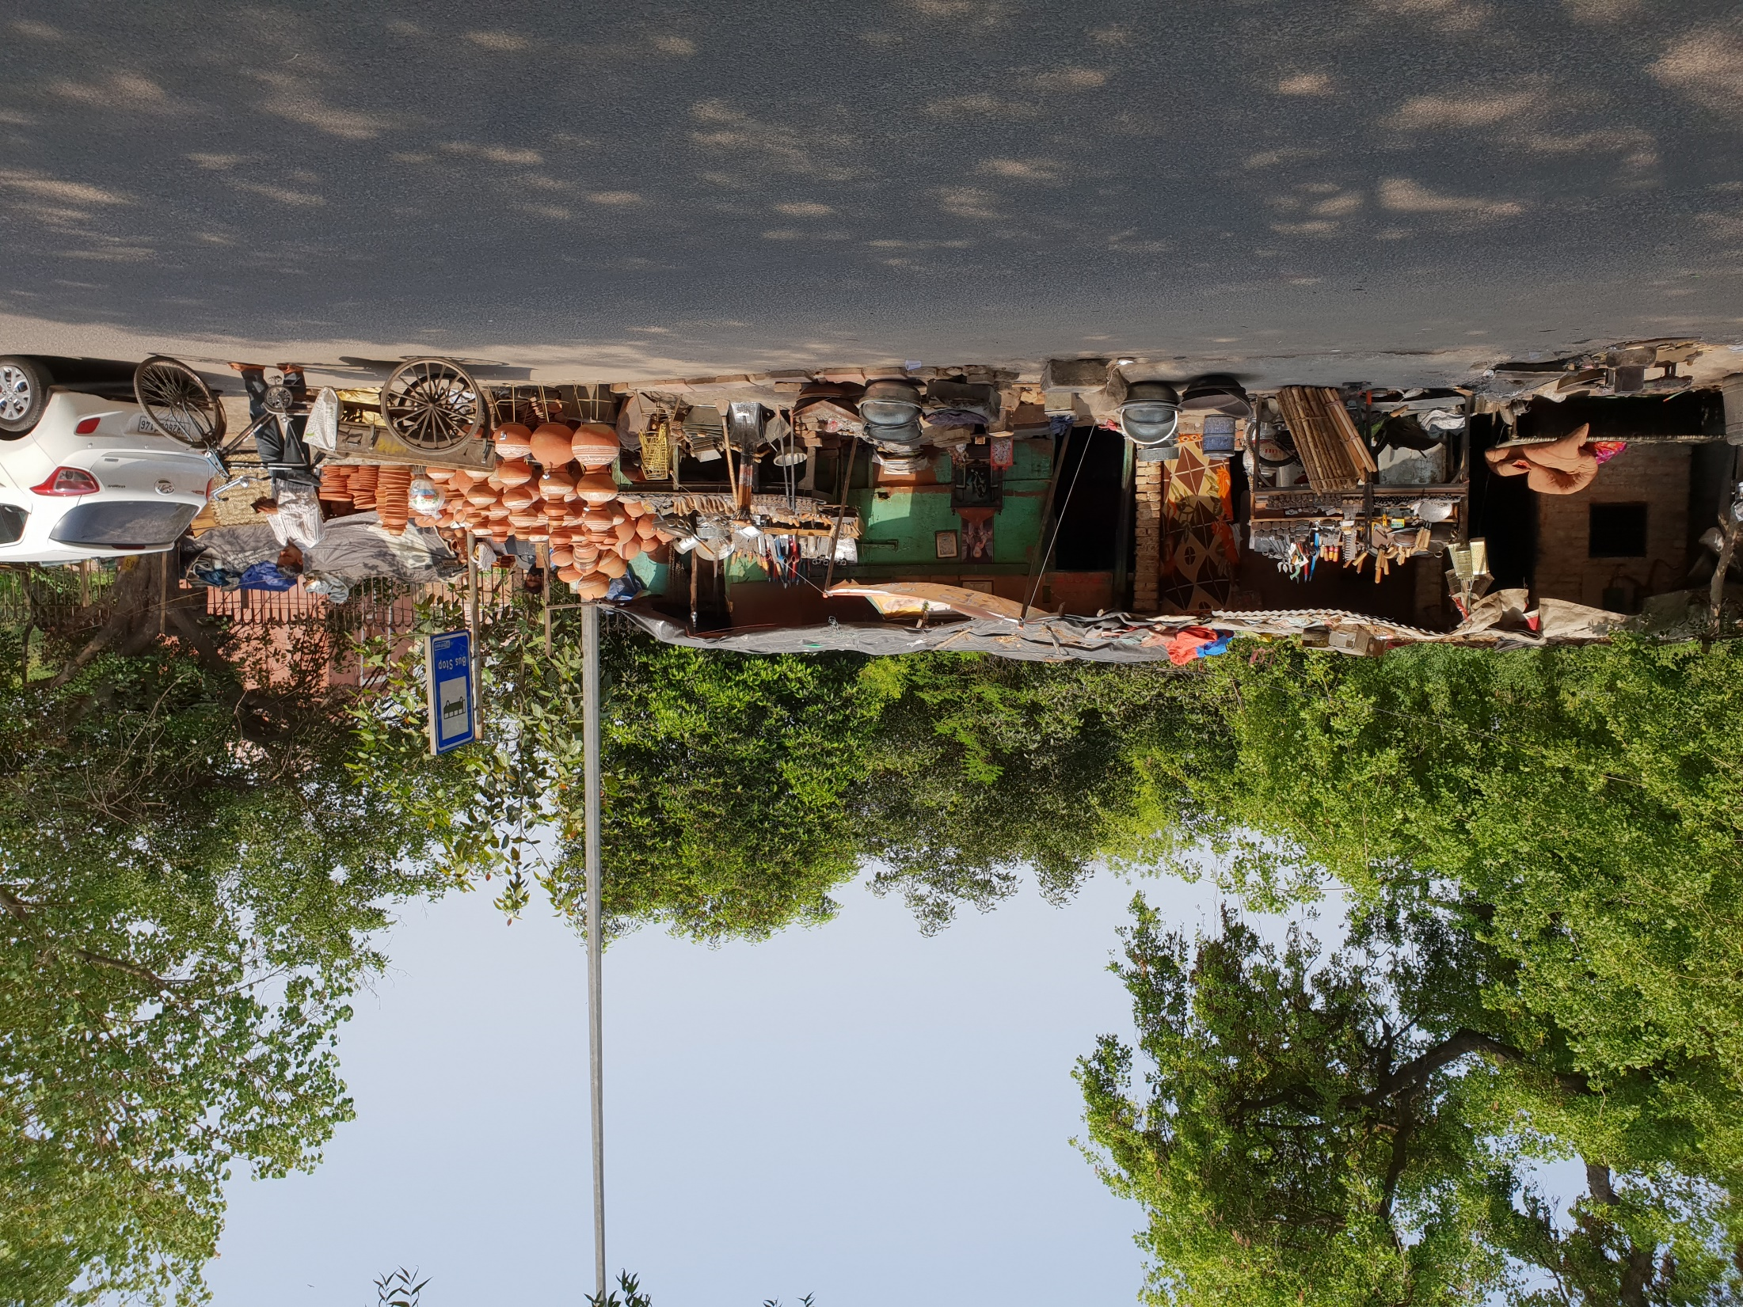
Notes:
Gadariya Lohar Home – Joint family

Slide 10
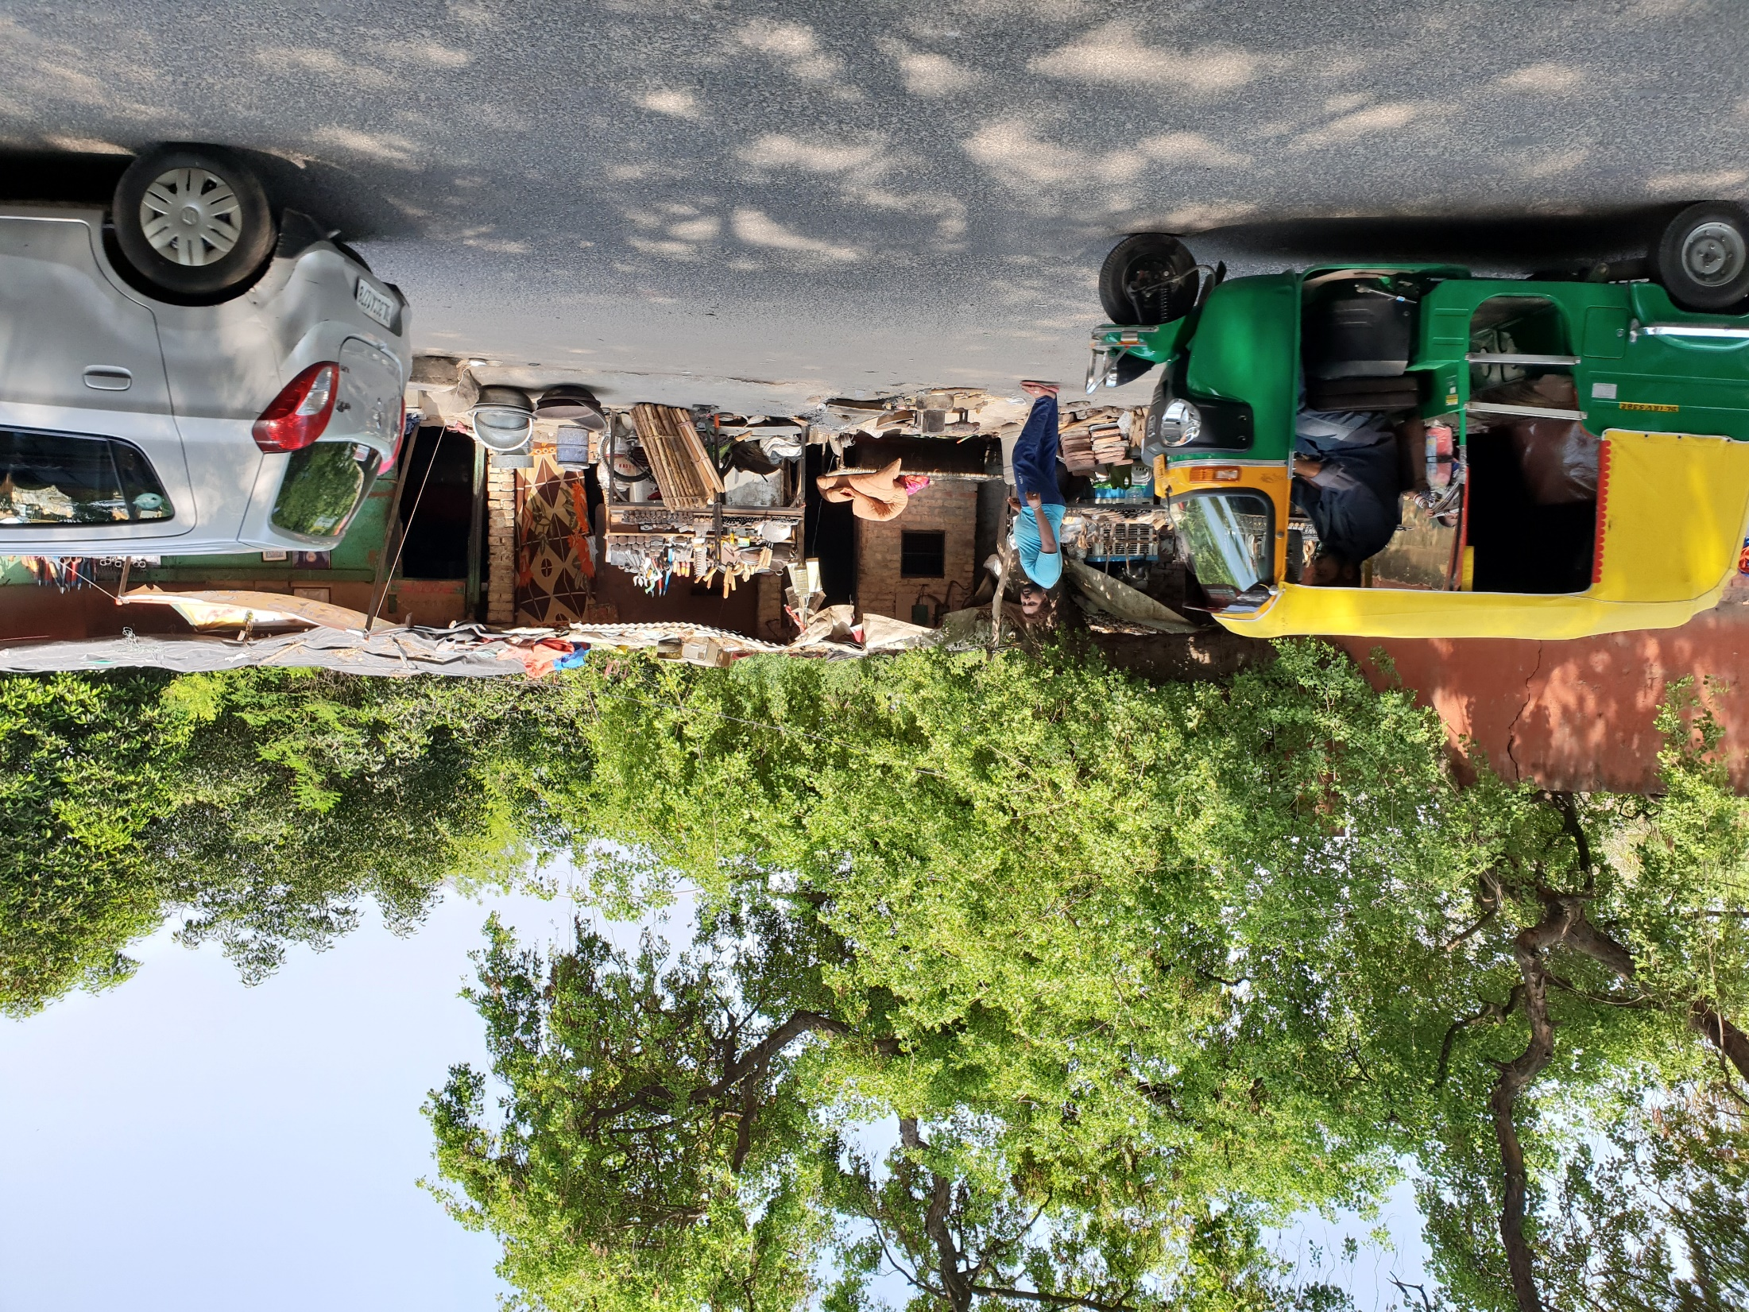
Notes:
GL family home abutting Lal Gumbad Monument in New Delhi

Slide 11
EMC
How does the family in the picture qualify as a member of EMC?
Own a Maruti car
Own a home on the outskirts of Delhi
One of the sons is attending a well-known private school in the area.

Slide 12
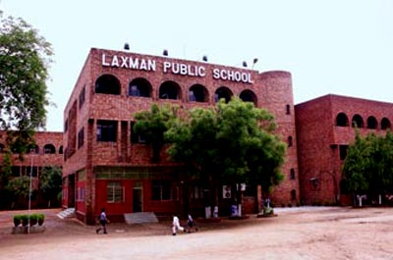
Private School where GL’s son is studying
Laxman Public School, New Delhi

Slide 13
Insecure circumstances of EMC – precarious existence
India continues to have among the highest rates of downward mobility. (Iversen et al 2017)
Larger among rural residents and among SCs and STs.
Between 3.5% and 6.6% of households in rural areas, and between 2.5% and 5% of households in urban areas, (total of 5%) fall below the poverty line each year on account of ill health and medical expenses
Krishna and Bajpayi (2015) - "fragility and volatility, rather than stability or continued progress, appear to characterize the new Indian middle class."

Slide 14
Performing middle class identities
Striving for upward mobility and security
Struggles over everyday belonging and prestige

Slide 15
Sites/strategies of pursuing and performing middle class identities
Much of the study of middle class focuses on consumption as the site of performativity
I turn the focus onto three different arenas for pursuing social mobility:
Family building, Education and Marriage

Slide 16
Displaying middle class status in marriage ceremonies
Lavish ceremonies with numerous guests – family, neighbours, friends, allow them to make statements about their status
* case of run away girl and its effects on family status;
Control over women greater among mobile families

Slide 17
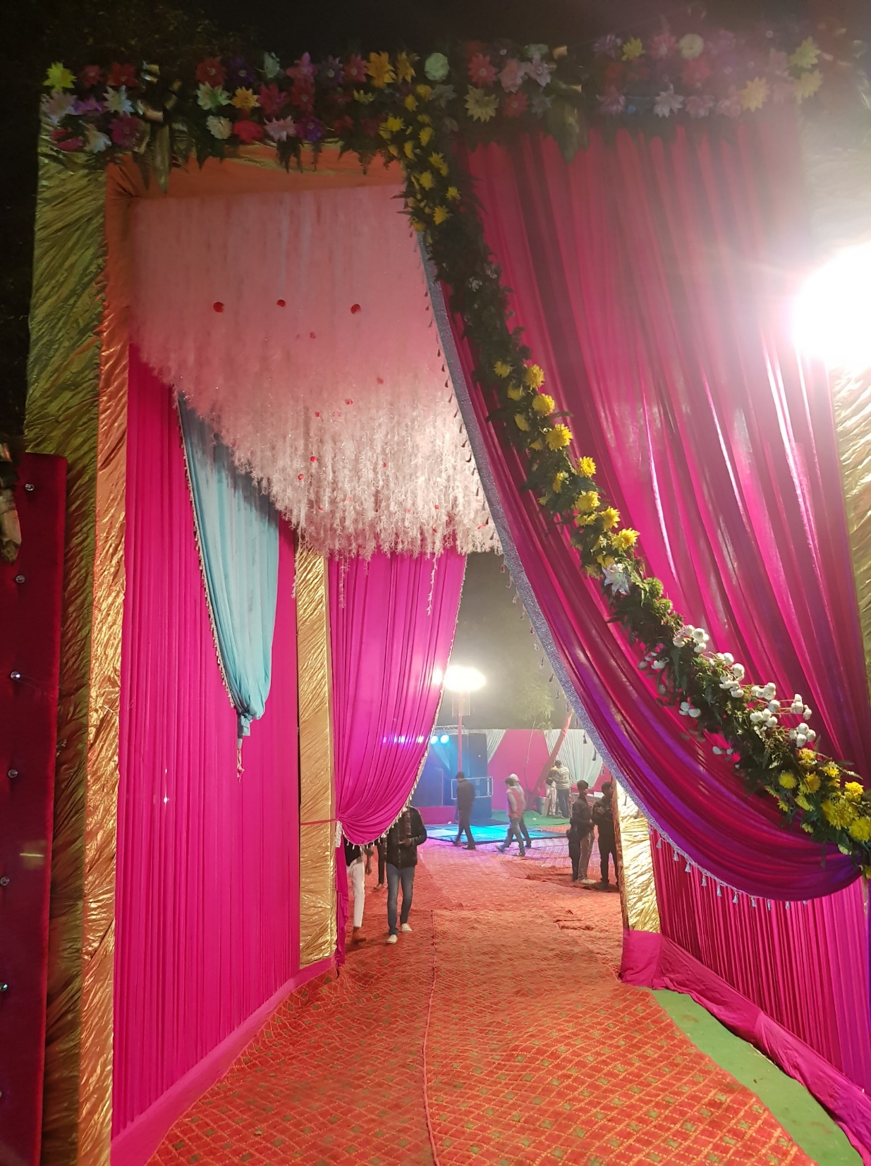
Notes:
Wedding of Daughter 2018

Slide 18
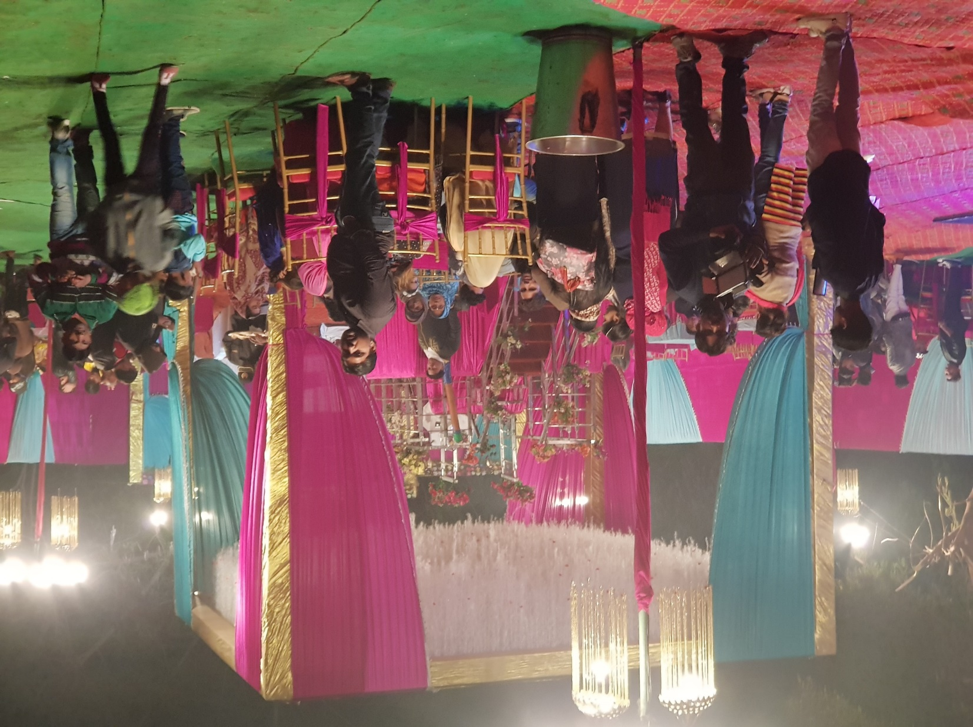

Slide 19
Sunita’s father’s story
Upward mobility through performing hypergamous marriage
Anxieties over performing middle class – typically articulated through consumption and values around “middle class morality”; women’s sexuality is closely regulated

Slide 20
Contexts of upward mobility strategies of families
Susan Greenhalgh -”I begin with the assumption that a basic goal of people everywhere is to secure and improve their social status and economic and political position in society.”

Slide 21
Strategies of upward mobility
Family building
Education
Marriage

Slide 22
Family building strategies
Family building strategies within a habitus/dispositions of son-preference/patriarchy
Gendered strategies; gendered outcomes

Slide 23
The “Modern Family”
Shaping a small sized family -presented as modern and patriotic; helping with the nation-building project, being civilized
Composition - Use of sex selection to have a small but son-biased family – modern, rational and scientific way of shaping the family

Slide 24
Gender-biased sex selection as mobility?
I make the case that not only is fertility mobility, but that gender-biased sex selection is also a family strategy to achieve mobility.
And that the desire of the growing “emerging middle class” to move up the ladder led to the steep deterioration in child sex ratios (1985-2005) and the phenomenon of “missing girls”

Slide 25
Class categories identified for the purposes of my study
Poor - income below Rs 8500 a month for a family of five
Emerging middle class (EMC): income between Rs. 8500 and Rs. 30,000
Stable middle class: Above Rs 30,000

Slide 26
Evolution of Emerging Middle Class, Middle Class and Sex Ratio at Birth
Emerging Middle Class (%)
Sex Ratio at Birth - Adjusted
Middle Class (%)
Source: Sample Registration System; Census
Note: 1. Sex Ratio at Birth is defined as number of boys born per 100 girls. The SRS data on SRB is adjusted to the Census child sex ratio for more accurate estimates.
2. The two income classes - poor, emerging middle class, and middle class - are based on household income. The range for each category for a family of five, per month, are: emerging middle class - between Rs. 8500 and Rs. 30000; middle class - greater than Rs. 30000.

Slide 27
Education
Gendered education strategies
More invested in sons education
Longer years of education
Private vs Government schools
Expensive Tuitions
Orientation of education
Careers for sons
Marriage for daughters

Slide 28
Investing in daughters
Watering the other’s garden?
Rise in age at marriage
Longer years of raising and nurturing a daughter –
No or few returns from daughters
Daughters a liability?
Especially more than one?

Slide 29
Marriage
Framed by exogamy/patrilocality
Too many daughters means outflow of wealth
Hypergamous marriages for daughters
Involve large dowries
But are important for status-raising and building new networks
Spatial hypergamy

Slide 30
Spatial hypergamy
Families seek to marry their daughters into socially higher families and to “suitable boys”
A typical EMC family would seek to marry their daughter/s into urban locations if they are based in the countryside or from less advantaged urban locations into bigger towns and cities.

Slide 31
Effects of spatial hypergamy on women’s status
Post-marriage, women who marry up and into more advantaged families and move to urban areas, often get withdrawn from work, for status reasons
Srinivas calls this the “status trap”
Papanek women’s work becomes “status –production work”

Slide 32
Consequences of gendered strategies
Families of women and their husbands gain but what are the consequences for women?
Withdrawal from work worsens their status; seen as not contributing to productive activities
Larger dowries demanded
Vicious cycle which leads to devaluation of women and of girl children

Slide 33
In conclusion
Gendered upward mobility strategies might help family mobility but they are detrimental to women’s status and the value of girl children
1985-2005 (and continuing) the EMCs strategies have had female unfriendly consequences
Precarity in patriarchal societies works against women and girls

Slide 34
In conclusion
Research also shows that as families move up into the stable middle class and have greater security, they tend not to discriminate against daughters
A small family with higher income, more educated women and working women, is more likely to not care about the sex of their children.

